Slide 1

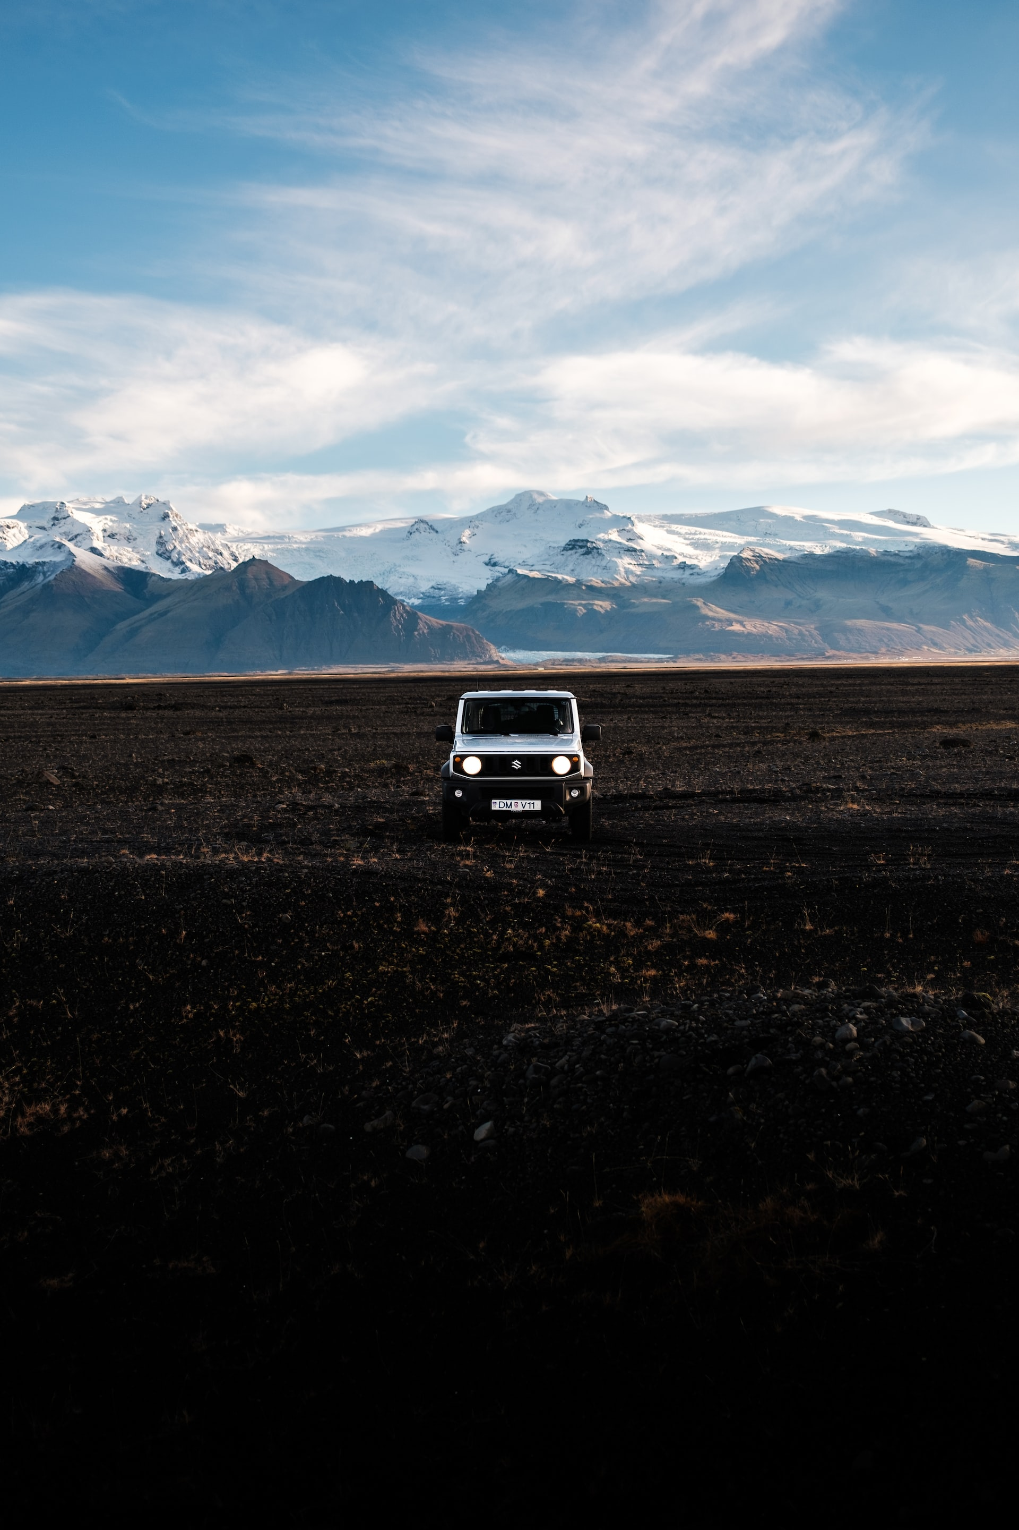
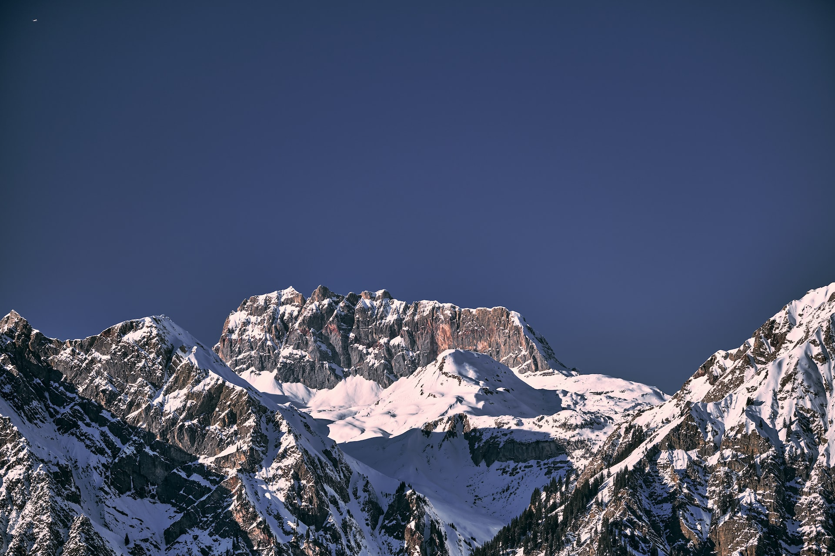
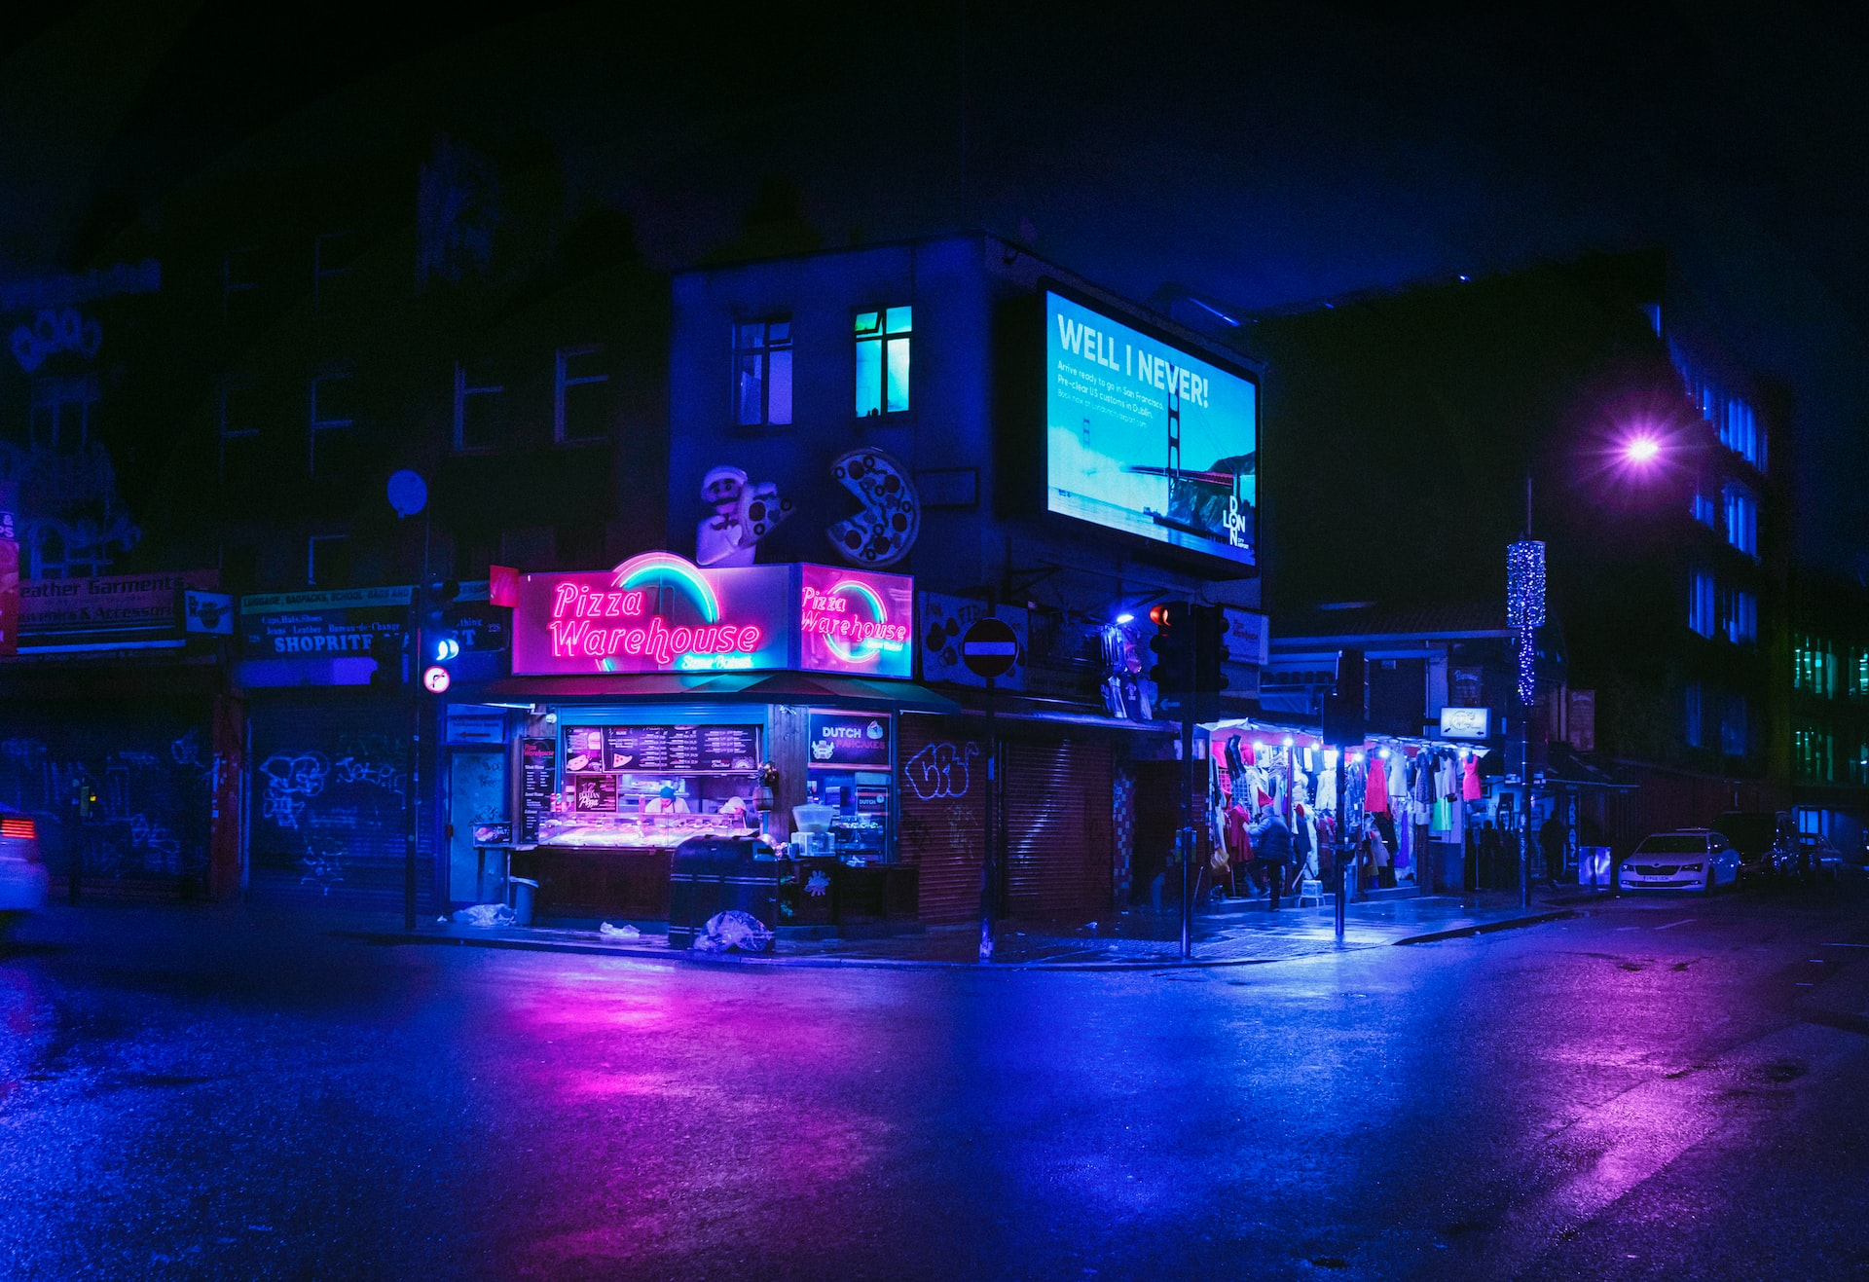
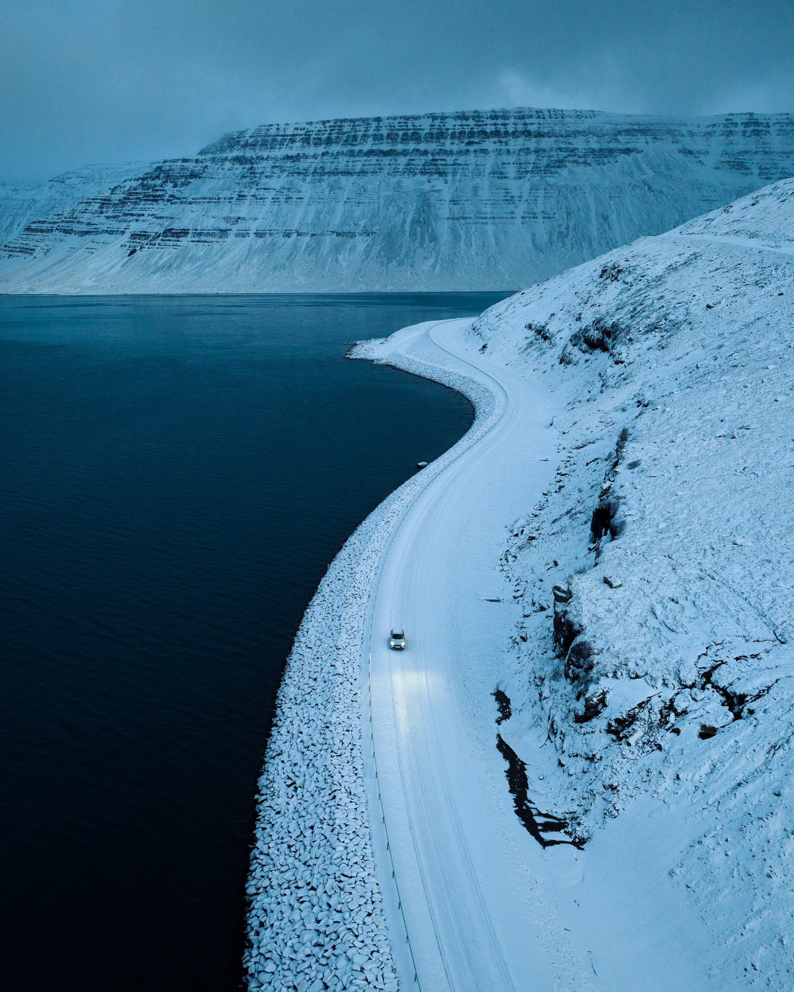
Landscapes

Slide 2
Landscapes

Slide 3

Landscapes
Marek Piwnicki
Photographer

Slide 4
Landscapes
Marcus Ganahi
Photographer

Slide 5
Landscapes
Thomas de LUZE
Photographer

Slide 6
Landscapes
Thomas De LUZE
Photographer

Slide 7
Landscapes
Jonathan Formanto
Photographer

Slide 8
Landscapes

